Slide 1
Cold Storage Management System Using DBMS
Presented by: Syed Hisham Azam
25WU0102282

Slide 2
Introduction
$ What is Cold Storage Management System?
A system used to manage commodities, storage chambers, customers, and inventory in a cold storage facility.
$ Why a DBMS?
DBMS provides a centralized and structured way of storing and managing data. It allows users to easily add, update, search, and retrieve information while maintaining data accuracy and reducing redundancy.
$ How does a DBMS help?
The main purpose is to streamline cold storage operations by providing accurate information about commodities, chambers, inventory, and transactions.

Slide 3
Problem Statement
$ diff -y “Problem Statement” “Objectives”
Manual record keeping makes it difficult to maintain accurate commodity and inventory information.
Develop a centralized database to maintain accurate and easily accessible commodity and inventory records.
Tracking chamber occupancy and available storage capacity can be time-consuming and error-prone.
Implement chamber management to monitor capacity and commodity allocation efficiently.
Data duplication and inconsistent records can occur when information is maintained across multiple manual records.
Use a structured database to reduce redundancy and maintain data consistency.
Lack of proper reporting makes it difficult to monitor and evaluate storage operations.
Generate useful reports for inventory, chamber utilization, and storage transactions.

Slide 4
System Features
$ ls “System Features”
  Better Inventory Tracking: Enables quick access to current commodity quantities, locations, and storage status.
  Faster Transaction Management: Simplifies the recording and retrieval of inward and outward commodity transactions.
  Easy Information Retrieval: Allows users to quickly access customer, commodity, chamber, and transaction details.
  Effective Monitoring & Reporting: Provides organized reports that support better monitoring and decision-making.

Slide 5
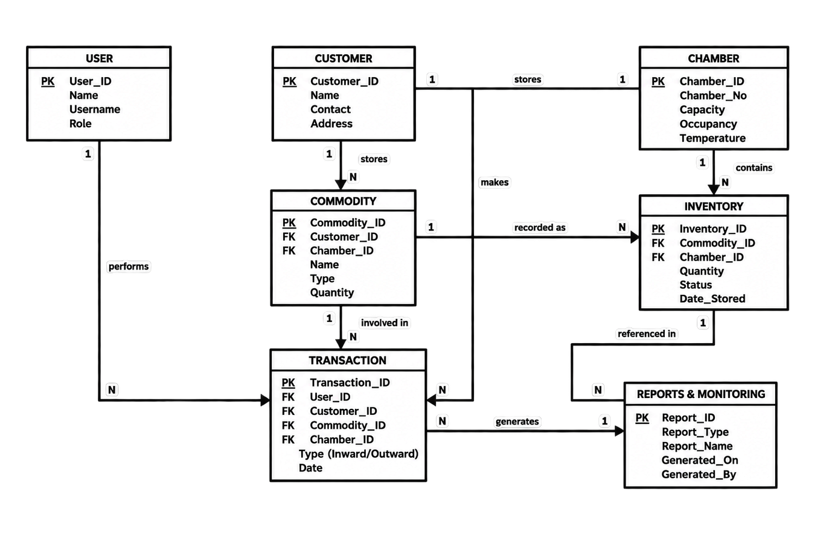
System Modules
$ tree Modules
Modules
│
├── User Management
│ ├── Login & Authentication
│ └── Access Control
│
├── Customer Management
│ ├── Customer Registration
│ └── Customer Records
│
├── Storage Management
│ ├── Chamber Management
│ │ ├── Chamber Details
│ │ ├── Capacity
│ │ └── Occupancy
│ │
│ └── Inventory Management
│ ├── Commodity Records
│ ├── Stock Tracking
│ └── Storage Location
│
├── Transaction Management
│ ├── Inward Transactions
│ └── Outward Transactions
│
└── Reports & Monitoring
├── Inventory Reports
├── Chamber Utilization
└── Transaction Reports
$ xdg-open ER_Diagram.png

Slide 6
THANK
YOU

